Slide 1



RealtorSphere
Makes Real Estate Easy
Project code: 24-1-D-18
Presented by Marina Shteinfer and Hanna Kruchenetzky
Advisor: Zeev Barzily
https://github.com/HannaKru/RealtorSphere https://realtorsphereapp.onrender.com/

Slide 2

Problem Overview
Inefficient Practices in Real Estate:
Traditional methods rely on excessive paperwork and disparate data sources.
Processes are often time-consuming and prone to errors.
Challenges Faced by Agents:
Increasing demands in the real estate market require quick adaptability.
Current methods fail to effectively engage customers and manage data.

Slide 3
RealtorSphere: A Modern CRM for Real Estate
Key Features
Edit and manage information about clients, owners, and properties
Track price suggestions and property details
Save events, tasks, and track communications
Matching properties to clients using hybrid matching algorithm
Assists agents in managing properties, clients, and owners.
Simplifies workflows and enhances customer engagement
Automates tasks, minimizing paperwork

Slide 4



Borcelle Company
Backend & Data Management
Firebase
Firebase Storage
Python and Flask
Cloud-hosted NoSQL database for real-time data sync
Secure file-saving capabilities
Powers backend routing and functionality

Slide 5


Development Tools
PyCharm: Primary development environment
GitHub: For version control and team collaboration
Render: For cloud deployment
RealtorSphere modernizes real estate processes
Reduces inefficiencies by minimizing paperwork and automating workflows
A comprehensive platform to help agents manage their business efficiently

Slide 6

Target Audience
Benefits for Property Owners
Properties will be targetes to the right audience using the matching algorithm
Benefits for Real Estate Agents
Benefits for Property Buyers
Streamlined Property Management: Organize, update, and track property details easily.
Improved Client Matching: Identify properties that match client preferences.
Accurate Data Management: Edit property, client, and owner data efficiently.
Task Management: Schedule appointments, manage diaries, and create reports.
Enhanced Customer Satisfaction.
Personalized Property Recommendations: Receive suggestions based on preferences.
Improved Communication: Realtors can send updates and property details through emails.
Better Buying Experience: Efficient handling of transactions and property matches.

Slide 7


Development Process
Research:
Investigated existing real estate software
Reached out to realtors to understand their needs and preferences
Explored how technology integrates with real estate
Technology & Algorithm Research:
Selected technologies based on project needs
Identified a matching algorithm to enhance deal efficiency
Requirements & Planning:
Created a list of functional and non-functional requirements
Designed software features based on realtor feedback
Development:
Chose tools and methodologies for efficient and effective development
Aim to deliver user-friendly, beneficial software for real estate agents

Slide 8

Tools and Methods we used:
Render & Web application:
Multi-Device Access: Works on computers, phones, tablets, allowing realtors to work from anywhere.
Responsive Design: Adapts to various screen sizes and devices.
Cloud Platform: Provides hosting and infrastructure services for web apps, databases, APIs, and static sites.
Goal: Eliminates the need for manual infrastructure management, making deployment more efficient.
Automatic builds and deployments
Autoscaling and server management
Simplifies the deployment process for developers
Development Advantages:
Fast development process
Supports multiple backend languages and tools (Node.js, Bootstrap, Tailwind CSS)
Accessibility: No installation required, only an internet connection and browser.

Slide 9

Version Control: GitHub
Collaboration & Code Management
Advantages
Branching & Merging:
Version control to track code alterations and roll back to earlier versions.
Central repository for seamless team collaboration.
Enables concurrent work on separate features without code conflicts.
Easy to create branches for new features or bug fixes and merge them back after approval.
Centralized platform for developers to collaborate on the same codebase.
Tracks changes and manages project workflow efficiently.

Slide 10
Hybrid Matching Algorithm
Purpose: Match the most accurate properties to potential clients.
Accurately match properties to potential clients using two algorithms.

Slide 11
1. Content-Based Filtering
Recommends properties based on user preferences and property attributes.
Cosine Similarity:
Measures similarity between client preferences (budget, size, type) and property attributes.
Formula:
CosineSimilarity=(x∗y)/(∣∣x∣∣∗∣∣y∣∣)
Focuses on the angle between data vectors, comparing multi-dimensional data.

Slide 12
2. Collaborative Filtering
Suggests properties based on preferences of similar users.
K-Nearest Neighbors (KNN):
Finds 'K' closest clients with similar preferences.
Uses these preferences to recommend properties to the target client.
Benefits:
Efficient property matching for clients.
Faster sales/rentals for owners.

Slide 13


Client-Server Model
Overview:
A communication model where a client program requests services from a server program.
Multiple clients can connect to a single server.
How It Works:
Client sends a request to the server via a network.
Server processes the request and sends back the data.
Uses common web protocols (DNS, HTTP, HTTPS).
Advantages:
Less maintenance required.
Independent updates: client and server can be changed separately.

Slide 14
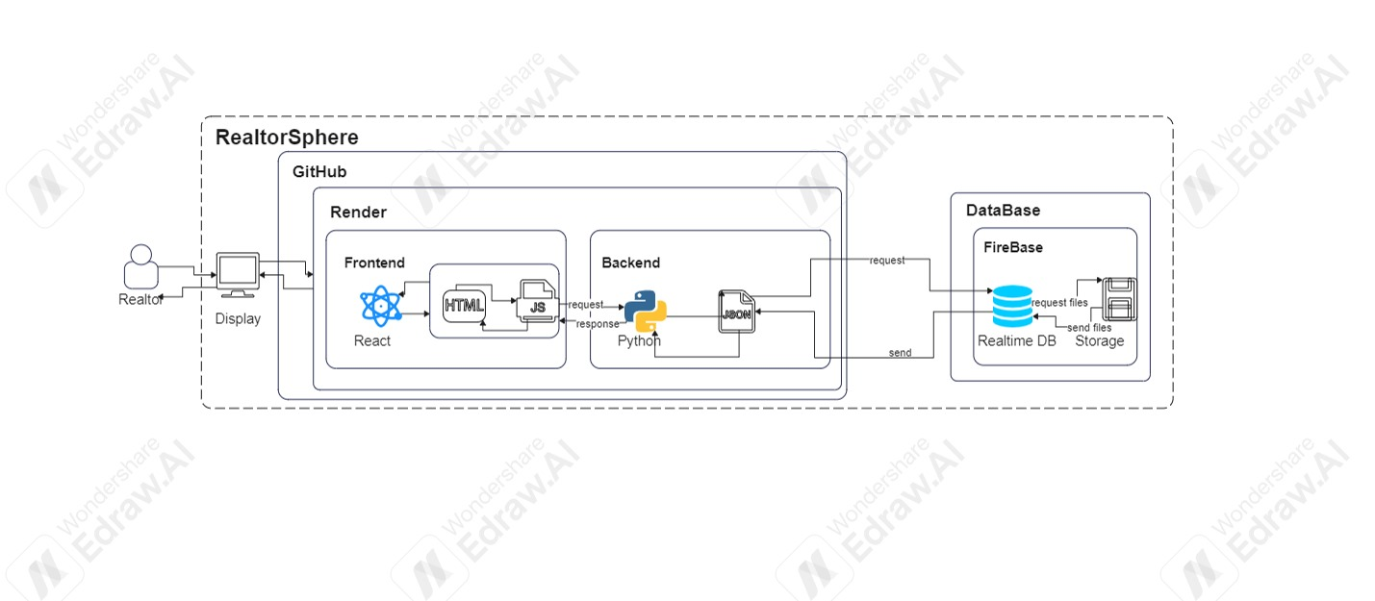
Archirecture:

Slide 15

Work Methodology: Agile
Agile Methodology:
Project is divided into small, manageable phases.
After each phase, feedback is gathered, allowing adjustments before the next phase begins.
Core Elements:
Collaboration between teams and trust.
Continuous cycle of planning, executing, and evaluating.
Key Benefits:
Flexible adjustments based on feedback after each phase.
Minimizes rework since the entire project isn’t fixed from the start.
Promotes continuous improvement and adaptability.

Slide 16
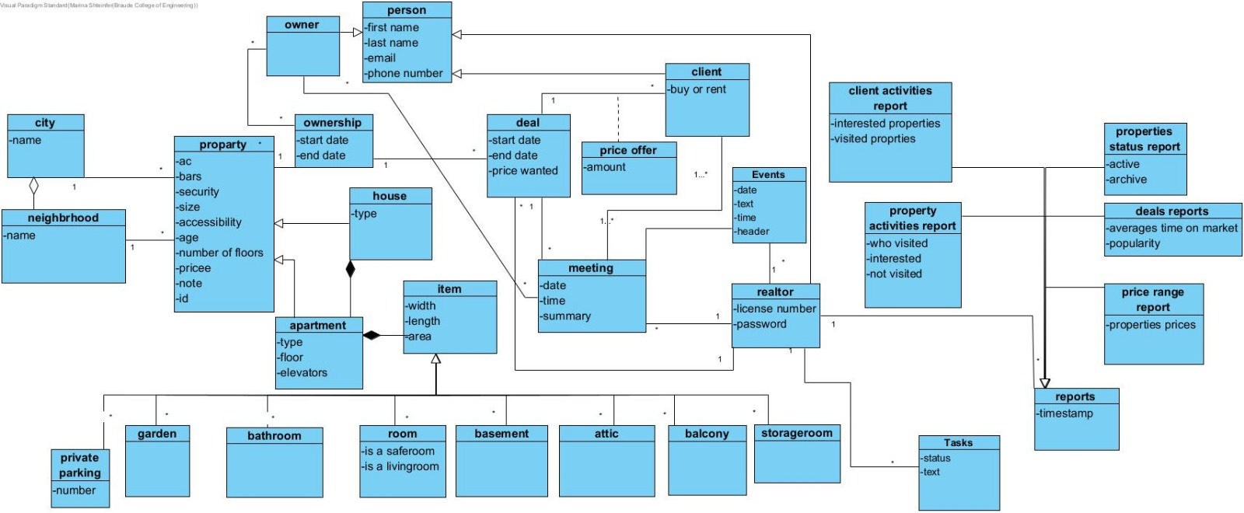
Class

Slide 17
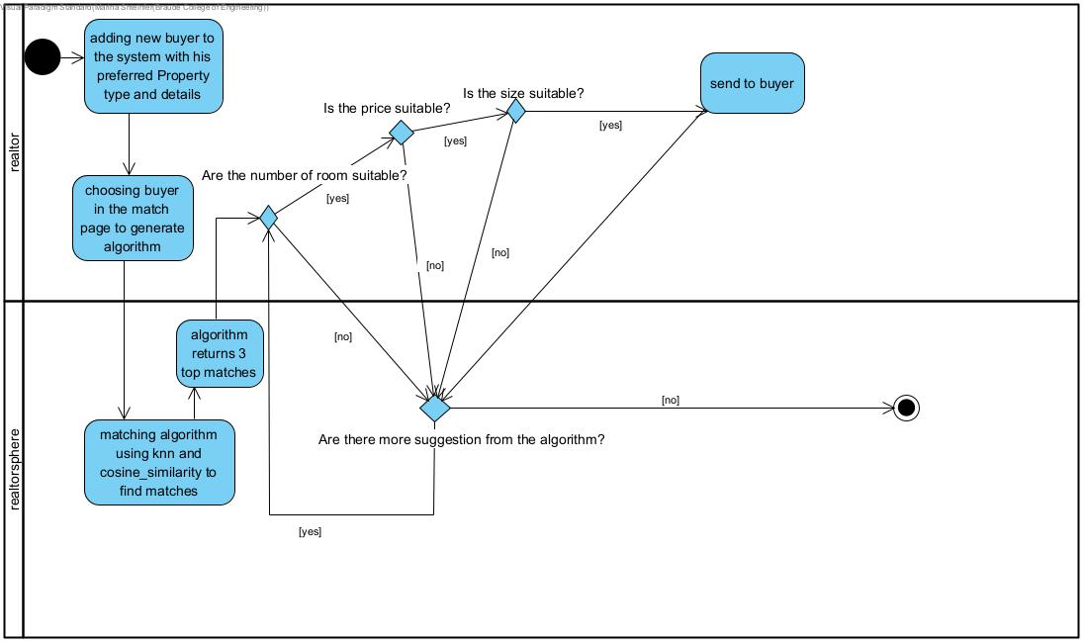
Activity

Slide 18
Challanges:
Platform Choice
Firebase Token Management
Firebase Connection Issues
Data Scraping Challenges
Time Constraints

Slide 19
Results and conclusions
Reflection
Website Development
Communication and Matching Features
Additional Features like Meeting management, price tracking, calendar notifications, and a to-do list.
User-Friendly Design
Challenges and Learning: Gained insights into realtors' needs through research and consultation, Acquired new skills with technologies like React, JavaScript, Firebase, and Render.
Improved time allocation could have allowed for even greater progress.
Dedicating an additional day per week solely to the project would have enabled the achievement of more goals.

Slide 20
Questions?

